Slide 1
Why Deep Blue Can’t Play Checkers
(and why today’s smart systems aren’t smart)
Mike Anderson, Tim Oates, Don Perlis
University of Maryland
www.activelogic.org

Slide 2
The Problem:
Why don’t we have genuinely smart systems, after almost 50 years of research in AI?

Slide 3
The Problem restated:
Why are programs so brittle?

Slide 4
Examples
The DARPA Grand Challenge robot that encountered a fence and did not know it.
II. The satellite that turned away and did not turn back.

Slide 5
Again restated:
How to get by (muddle through) in a complex world that abounds in the unexpected?
Notes:
All of AI probably fits under this umbrella theme.

Slide 6
Sample “unexpecteds”
Missing parens
Word not understood
Contradictory info
Language change
Sensor noise
Action failed, or was too slow
Repetition (loop)

Slide 7
The good news: Humans are great at this, and in real time.
Notes:
That is, we tend to adjust to difficulties. We might not always solve the problem at hand, or solve it fast, or without help. But we do not go into an infinite loop, nor do we crash. By and large we keep going effectively, if not on one problem then on another.

Slide 8
People readily adjust to such anomalies.
So, what do people do or have, that computers do not?
Is this just the ability to learn?
Notes:
Stated that way, it is hard to formulate an algorithm; there might be thousands of special-purpose adjustments.

Slide 9
No, not just the ability to learn, but also the ability to know when, what, why, and how to learn, and when to stop; i.e., a form of meta-learning.

Slide 10
Is this “meta-learning” ability an evolutionary hodgepodge, a holistic amalgam of countless parts with little or no intelligible structure?
Or might there be some few key modular features that provide the “cognitive adequacy” to muddle through in the face of the unexpected?
Notes:
We think there is strong evidence for the latter, and we have a specific hypothesis about it and how to build it in a computer.

Slide 11
We think there is strong evidence for the latter, and we have a specific hypothesis about it and how to build it in a computer.

Slide 12
What people do
People tend to Notice when an anomaly occurs.
People Assess the anomaly in terms of options to perform.
3. People Guide an option into place.
We call this N-A-G cycle the metacognitive loop (MCL)

Slide 13
Note that we are NOT saying people easily come up with clever solutions to tricky puzzles (e.g., Missionary and Cannibals, Three Wise-Men, Mutilated Checkerboard).
People are, rather, perturbation-tolerant, e.g., knowing when to give up, or to ask for help, or to learn, or to ignore the anomaly.
Notes:
Stating the problem this way lends itself to the beginnings of a solution: perturbations from expectations are the key. An agent has (or should have) expectations as to what is what, and can (or should) be able to tell when this is not the case (at least sometimes).

Slide 14
MCL details -- note an anomaly
Simplest case is also quite general: monitor KB for direct contradictions, i.e., of the form
E & -E
or of the special-case form
Expect(E) & Observe(-E)
Notes:
(But how learn what to expect? Pattern recog, advice, etc.)

Slide 15
MCL details -- assess anomaly
what sort is it--similar to a familiar one, sensor-error, repeat state (no progress), etc--and how urgent is it
what options are available for dealing with it (ignore, postpone, get help, check sensors, trial-and-error, give up, retrain, adapt stored response, infer, etc)
Notes:
(probabilistic reasoning can play a useful role here). Probably use list of lists…

Slide 16
MCL details -- guide response
Choose among available options (e.g., via priorities or at random)
Enact chosen option(s); this may involve invoking training algorithms for one or more modules, and monitoring their progress.
Can recurse if further anomalies are found during training.

Slide 17
With training/adapting, what had been anomalies can sometimes become familiarities, no longer taking up MCL cycles (i.e., the architecture provides for automatization).

Slide 18
An Example
A behavioral deficit (e.g., in bicycling) can be “fixed” by training, or by
Reasoning out a substitute behavior, (e.g. buy a car), or by
Popping to a higher goal (e.g., get someone else to take over; or even change goals).
Notes:
What about the possible thousands of special-purpose adjustments that may be called for in thousands of special-case anomalies? MCL offers the means to learn an adjustment that, once learned, becomes automatized, no longer requiring MCL to invoke it. Thus an anomaly can become a regularity.

Slide 19
The long-range goal
Build a general MCL-enhanced agent and let it learn about the world at large.

Slide 20
Mid-range goal
Build a task-oriented MCL-enhanced agent, and let it learn to perform the task (better and better), even as we (or the environment) introduce anomalies.

Slide 21
Pilot Applications
In our ongoing work, we have found that including an MCL component can enhance the performance of—and speed learning in—different types of systems, including reinforcement learners, natural language human-computer interfaces, commonsense reasoners, deadline-coupled planning systems, robot navigation, and, more generally, repairing arbitrary direct contradictions in a knowledge base

Slide 22
MCL Application: ALFRED
ALFRED is a domain-independent natural-language based HCI system. It is built using active logic.
ALFRED represents its beliefs, desires, intentions and expectations, and the status of each. It tracks the history of its own reasoning.
If ALFRED is unable to achieve something, something is taking too long, or an expectation is not met, it assesses this problem, and takes one of several corrective actions, such as trying to learn or correcting an error in reasoning.
Notes:
ALFRED is our domain-independent natural language based HCI system.
Note that, in light of the considerations aired earlier, we have enhanced the BDI architecture with expectations—these expectations drive the anomaly detection in ALFRED.
We have been improving ALFRED by expanding it to several different domains, and improving the number and type of problems it can deal with.

Slide 23
MCL Application: ALFRED
  Example:
  User : Send the Boston train to Atlanta.
  Alfred: OK. [ALFRED chooses a train (train1) in Boston and sends it to Atlanta]
  User : No, send the Boston train to Atlanta.
  Alfred: OK. [ALFRED recalls train1, but also notices an apparent contradiction: don’t send train1, do send train1. ALFRED considers possible causes of this contradiction, and decides the problem is his faulty interpretation of “the Boston train” as train1. He chooses train2, also at Boston, and sends it to Atlanta]

Slide 24
MCL Application: Learning
Chippy is a reinforcement learner (Q-learning, SARSA, and Prioritized Sweeping), who learns an action policy in a reward-yielding state space.
He maintains expectations for rewards, and monitors his performance (average reward, average time between rewards).
If his experience deviates from his expectations (a performance anomaly that we cause by changing the state space) he assesses the anomaly and chooses from a range of responses.
Notes:
We have also applied MCL to reinforcement learning. In one set of experiments recently completed, we created a standard and an MCL-enhanced reinforcement learner (using Q-learning, SARSA, and Prioritized Sweeping), put them in an 8x8 grid world, allowed them to learn a policy, and then perturbed the world by changing the reward values. The MCL reinforcement learner, in contrast to the standard one, was able to notice that something was wrong, and take specific steps to overcome the problem.

Slide 25
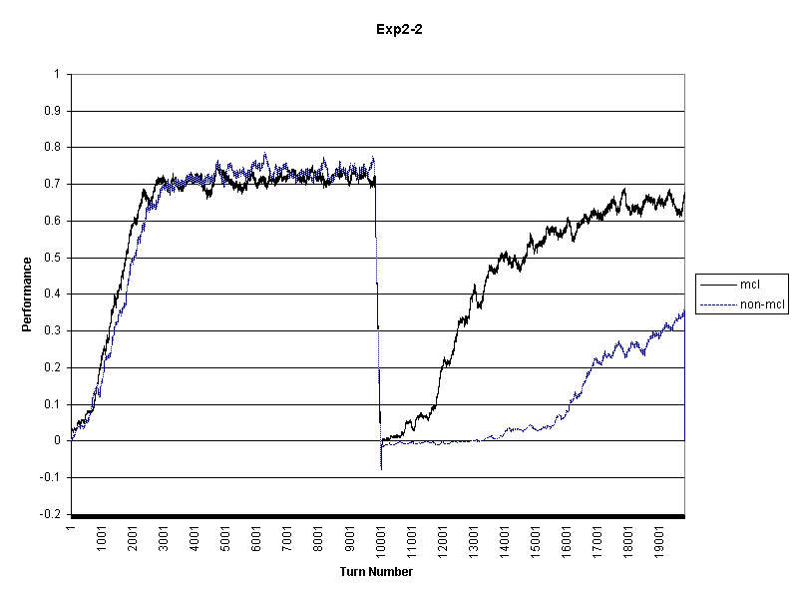
Comparison of the per-turn performance of non-MCL and simple-MCL with a degree 8 perturbation from [10,-10] to [-10,10] in turn 10,001.

Slide 26
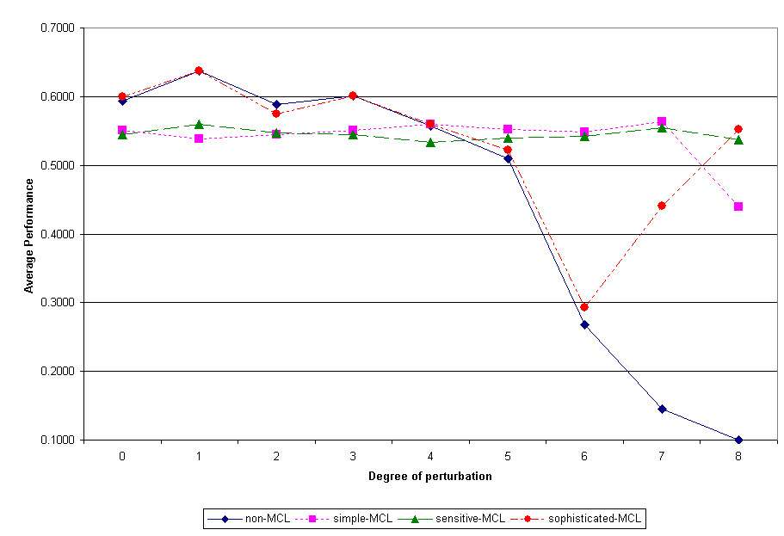
Notes:
We found that the perturbation tolerance of reinforcement learners varied considerably, and was negatively correlated with the degree of the perturbation. (Here we are defining perturbation tolerance in terms of post-perturbation performance.) Further, we found that even a very unsophisticated MCL component could improve the perturbation tolerance of a reinforcement learner, and that the degree of improvement was positively correlated with the degree of the perturbation.
Future plans include more sophisticated response strategies, including directed exploration of the world, and self-shaping to speed re-learning.

Slide 27
Current Work: Bolo
Bolo is a tank game. It’s really hard.
For a first step, we will be implementing a search-and-rescue scenario within Bolo.
The tank will have to find all the pillboxes and bring them to a safe location.
However, it will encounter unexpected perturbations along the way: moved pillboxes, changed terrain, and shooting pillboxes.

Slide 28
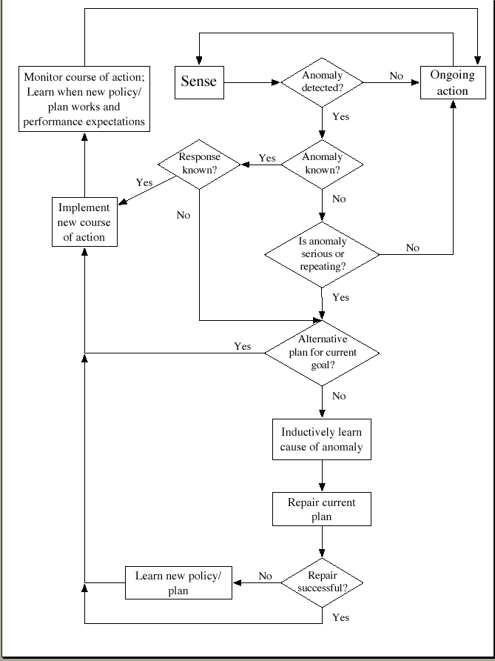

Slide 29
a demo…

Slide 30
Some Publications
Logic, self-awareness and self-improvement: The metacognitive loop and the problem of brittleness. Michael L. Anderson and Donald R. Perlis. Journal of Logic and Computation, 15(1), 2005.
The roots of self-awareness. Michael L. Anderson and Don Perlis. Phenomenology and the Cognitive Sciences, 4(3), 2005 (in press).

Slide 31
THANKS FOR LISTENING !

Slide 32
FIN

